Slide 1

How do women active in risk & insurance management reach top management level?
Cécile Coune
CEO for Belrim, Ladies Mind Risk
22 January 2015
1

Slide 2
Flash-back on a 25(+) year career in insurance
  At the crossroads
  When hitting the ground
  Inspiring leaders
  The importance of networks
2

Slide 3
At the crossroads
Success is a mix of talent, hard work and luck
Ambition is a quality
Know what you want & be ready to fight for it
Never compromise integrity
Success breeds success
Do not anticipate problems, solve them as they materialize (they might not)
Take P&L responsibility
Choose your partner in life

Slide 4
The importance of networks
  Professional networks (insurance/others)
  Women vs. mixed networks
  Women on Board (Belgium)
  European Women on Boards

Slide 5
When hitting the ground
A career is not necessarily a straight road
Have faith
Have fun
Resilience
Can-do attitude
Humility
Continuous learning

Slide 6
Inspiring leaders
Look for
  Inspiring leaders
  Champions
  Mentors
Make your expectations known, as well as your readiness
Do not rely on performance only

Slide 7
The importance of networks
  Professional networks (insurance/others)
  Women vs. mixed networks
  Women on Board (Belgium)
  European Women on Boards

Slide 8
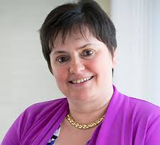
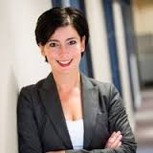
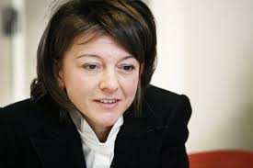
A few other CEO’s in insurance

Slide 9
Board of Directors Assuralia
Voorzitter: Hans Verstraete (KBC Verzekeringen)
Ondervoorzitter: Bernard Thiry (Ethias)
Gedelegeerd bestuurder: Philippe Colle (Assuralia)
Rudy Benmeridja (Amlin Europe)
Jean-Marie Bollen (Ergo)
Antonio Cano (AG Insurance)
Christophe Cherry (Atradius Credit Insurance)
Gustaaf Daemen (DAS)
Hans De Cuyper (AG Insurance)
Damien de Laminne de Bex (DKV Belgium)
Gert De Winter (Baloise Insurance)
Koen Depaemelaere (AXA Belgium)
René Dhondt (Assuralia)
Herman Falsté (AMMA Verzekeringen)
Quinten Fraai (ING Life en Non-Life Belgium)
Eric Kleijnen (Belfius Insurance)
Frank Koster (AXA Belgium)
Luc Kranzen (Ethias)
Jan Leflot (QBE Reinsurance (Europe) Ltd Secura Branch)
Christophe Marius (AXA Assistance)
Tom Meeus (FEDERALE Verzekering)
Wilfried Neven (Allianz Benelux)
Christophe Roelandt (Protect)
Edwin Schellens (Fidea)
Johan Thijs (KBC Groep)
Jan Van Autreve (Delta Lloyd Life)
Ilona Van Hemelrijk (AGA)
Patrick Vandoren (KBC Verzekeringen)
Hilde Vernaillen (P&V Verzekeringen - Vivium)
Marc Vrijman (AVIVA Vie-AFER)

Slide 10


HOW LONG BEFORE A GENDER EQUAL SOCIETY
European projections estimate that, at the current rate of change, it will take almost 30 years to reach the EU’s target of 75% of women in employment, over 70 years to make equal pay a reality, over 20 years to achieve gender balance on the boards of Europe’s largest publicly listed companies and almost 40 years to ensure that housework is equally shared between women and men.
10

Slide 11
WHOPPING GENDER IMBALANCE ON BOARDS
Gender imbalance on corporate boards remains an important challenge for all EU Member States. It constitutes an untapped potential of skilled human resources, as evidenced by the discrepancy between the high number of female graduates and their underrepresentation in top-level positions.
Women in economic decision making in the EU – 2012 Progress Report
11

Slide 12
WHY GENDER BALANCE ON BOARDS MATTERS
In testing the performance of 2,360 companies globally over the last six years, Credit Suisse research shows that it would on average have been better to have invested in corporates with women on their management boards than in those without. Their research also find that companies with one or more women on the board have delivered higher average returns on equity, lower gearing, better average growth and higher price/book value multiples over the course of the last six years.
Gender diversity and corporate performance, Credit Suisse Research Institute – August 2012
12

Slide 13
WHY GENDER BALANCE ON BOARDS MATTERS
For seven years, McKinsey’s annual Women Matter studies have pointed out that companies with a « critical mass » of female executives perform better than those with no women in top management positions. They found that one reason for this outperformance lies in the leadership behaviors that women leaders tend to exhibit more often than their male counterparts (people development, expectation & rewards, role model, …)
Women Matter 2013
13

Slide 14
The Europe 2020 Strategy
EU’s growth strategy leans on knowledge, competences and innovation. Human capital is key for addressing the demographic challenges of falling birth rates and an ageing society.
One of the ways to improve Europe’s competitiveness can be a more balanced representation of women and men in economic decision-making positions, which can contribute to a more productive and innovative working environment.
Women in economic decision making in the EU – 2012 Progress Report
14

Slide 15
WHY ARE WOMEN UNDEREPRESENTED ON BOARDS?
Men (42%) largely believe that the “lack of women in executive ranks” is the primary reason that the percentage of women on boards is not increasing. Women (35%) say it stems from the fact that “traditional networks tend to be male-oriented.”
Heidrick & Struggles and WCD
Board of Directors Survey 2012
15

Slide 16
ARE THERE (ENOUGH) QUALIFIED BOARD READY WOMEN?
In a recent assessment of US boards, Groysberg and Bell discovered that female board members actually had far more operational experience on their résumés than male board members, on average. They also found that the majority of female board members reported having actively sought their board seats. The same was not true of male board members.
Carmen Nobel, Senior editor of Harvard Business School Working Knowledge
14 January 2013
16

Slide 17
ARE THERE (ENOUGH) QUALIFIED BOARD READY WOMEN?
"There aren't too many corporate board seats that open up each year. We're not talking about millions. We're not even talking about thousands. Please. Don't tell me you can't find 100 qualified women to sit on boards in the United States of America.“ Groysberg says.
17

Slide 18
WHY WOMEN ON BOARD?
Back in 2009, in Brussels (Belgium)
« We would like to have more women on boards but we do not know where to find them. »
Anonymous
Excuse or reality?
We demonstrate that in Belgium, there are enough qualified board-ready women.
Women on Board is a facilitator between board-ready women and the business world.
It is not a quota lobby or a women’s club.
18

Slide 19
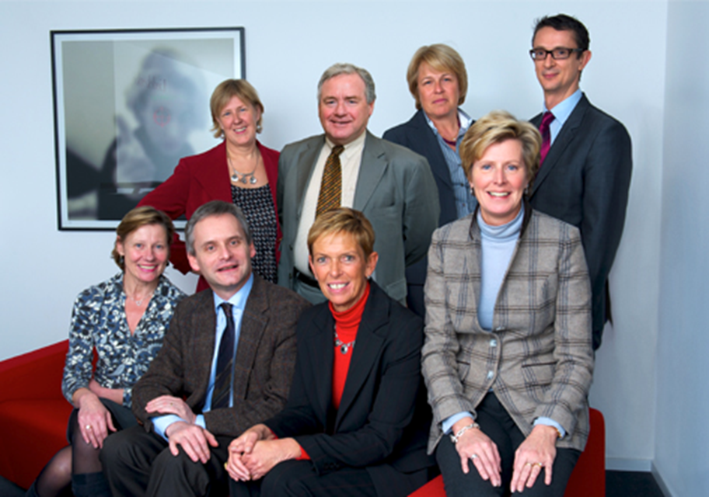
Women on Board’s BoD
12 June 2014
19

Slide 20
Achievements after 5 years
  Over 200 effective members (board-ready women) on 31/12/2014
  Mentoring program with Guberna, second edition (program 2014-2015)
  Several events each year
  A 1st class women network
12 June 2014
20

Slide 21
Status on Board positions – Use of WoB’s pool
 | 2012 | 2013 | 2014
Access to pool granted to enterprises /search firms | 15 | 28 | 32
Board nominations | 11 | 30 | Over 35 (TBC)

Slide 22
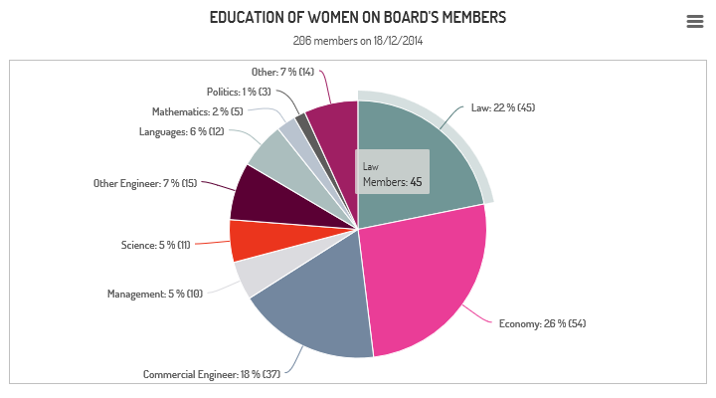
STATISTICS OF WoB POOL
12 June 2014
22

Slide 23
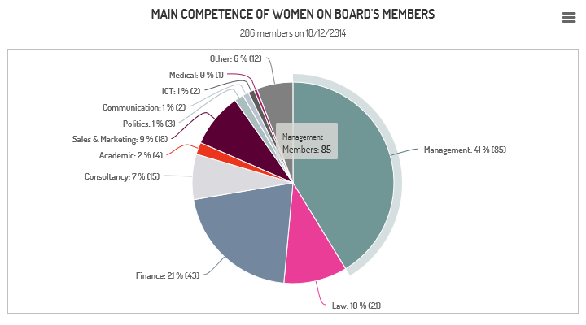
STATISTICS OF WoB POOL
12 June 2014
23

Slide 24
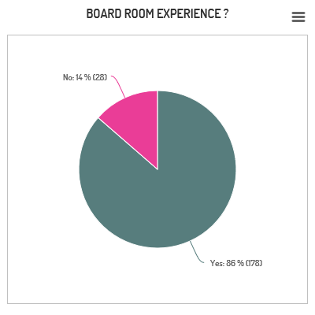
STATISTICS OF WoB POOL
12 June 2014
24

Slide 25
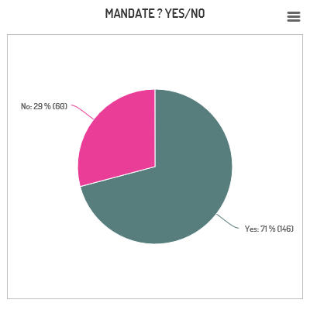
STATISTICS OF WoB POOL
12 June 2014
25

Slide 26
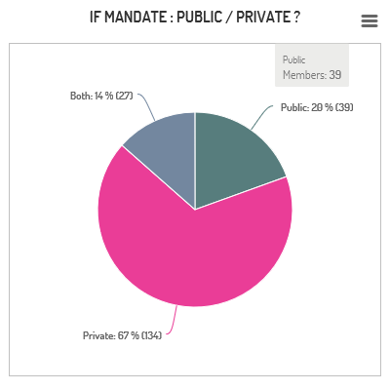
STATISTICS OF WoB POOL
12 June 2014
26

Slide 27
ORGANIZATION OF EVENTS
  Organization of events to provide visibility and networking
    McKinsey: Centered Leadership focusing on "Meaning".
    Liedekerke - “La responsabilité des administrateurs”
    Egon Zehnder - “What do companies look for when recruiting board members? How to maximize the chances of getting your first board seat?”
    Fieldfisher - "Group of Companies - a tax, criminal and IP perspective“
    BNP Paribas : Gender Diversity to challenge the management.
    General assembly meetings
    New Year cocktail parties
    « Speed dating » events
    Etc.
12 June 2014
27

Slide 28
Press clippings
De Morgen, Trends-Tendances,
De Tijd-L’Echo, Paris Match, Datanews, Nieuwsblad, Notarius, De Standaard,…

Slide 29
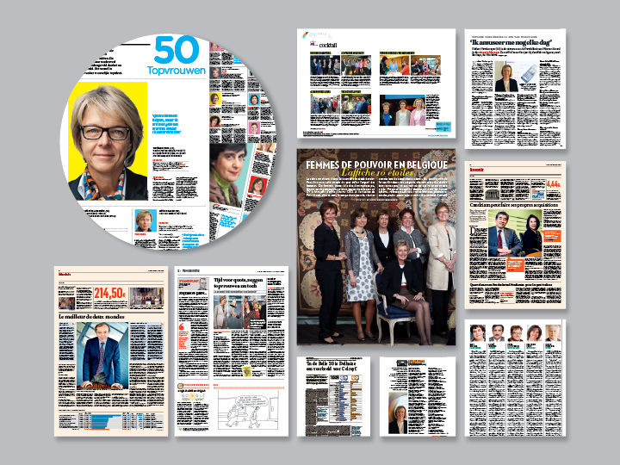


Slide 30
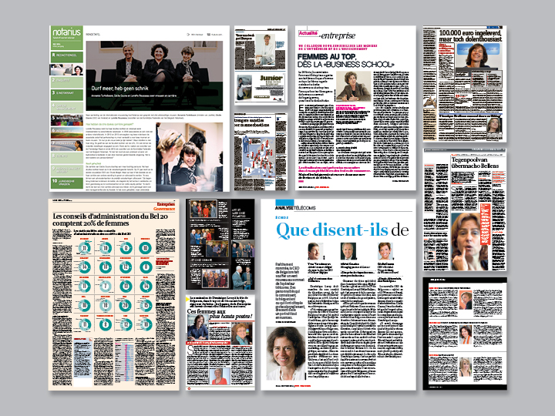

Slide 31
INTERNATIONAL VISION
From day one, at Women on Board, the vision was to grow internationally. Enterprises are globally active and looking for board members across borders.
In June 2013, Women on Board co-initiated the creation of the European Women on Boards association, to facilitate networking between "best of class" associations across Europe, that share the same goals and values.
12 June 2014
31

Slide 32
EUROPEAN WOMEN ON BOARDS
Non-profit organization created in Brussels on 20 June 2013
EWoB Network project funded by the European Union
EWoB has the conviction that gender balance on boards is not an end in itself but a business opportunity.
12 June 2014
32

Slide 33

Mission of EWoB
European Women on Boards (EWOB) is a unique network of organizations promoting female participation on boards of directors across Europe.
EWoB has the conviction that greater gender diversity on boards is not an end in itself but a business opportunity:
  to create diversity of competencies, expertise, skills, and backgrounds in line with boards’ needs, for competitiveness and sustainable growth, far beyond an "equitable" issue,
  to promote best practice of governance combining performance and ethics, because effective boards and effective directors are needed to face growing duties and responsibilities in a complex decision-making environment,
  to contribute to build up innovative strategy, as diversity of talents facilitates diversity of thinking to come up with efficient and break-through strategy in a fast changing business environment,
  to get the board play an exemplary role in the dynamic of valuation of the whole female capital of the company.
v

Slide 34
EUROPEAN WOMEN ON BOARDS
As a result, its main goals are:
  to develop the premier European network of "first tier" non-profit organizations aimed at promoting and increasing the supply of women on boards, to address the quantitative shortfall of women on boards in Europe
  to promote a valuable female talent pool and thus to contribute to improve the efficiency of the "market" for board mandates at European level, to cope with a lack of accessibility and visibility to boards preventing many highly talented women from reaching these top decision-making positions, and to increase international visibility of board-ready women and understanding of their added value to boards,
  to participate actively in the debate on how diversity on boards can contribute to improvements on the one hand, in the best practice of corporate governance and, on the other hand, in innovation and more balanced business models, when there is a pressing need for companies to improve their competitiveness and to rethink their business models.
EWoB will pursue these objectives with strong principles of ethics based on its core values, the Seven I’s: Innovation, Inclusiveness, Intelligence, Integrity, Involvement, Interaction, Intangible assets.
12 June 2014
34

Slide 35
EUROPEAN WOMEN ON BOARDS
Four founding members: Women on Board Belgium, Board Professionals Finland, Norwegian IoD, French AFECA
Co-chairs: Cécile Coune and Marie-Ange Andrieux
Broadening membership: goal of 6 new members in 2014
  Additional Members so far: IoD in UK, Financi’Elles in France, FidAR in Germany, Talent naar de Top in the Netherlands
  Contacts are currently ongoing in Italy, Denmark, Spain
Projects 2015:
  Annual Survey
  Launch International Mentoring Program
  Create the international « pool of talent »
12 June 2014
35

Slide 36
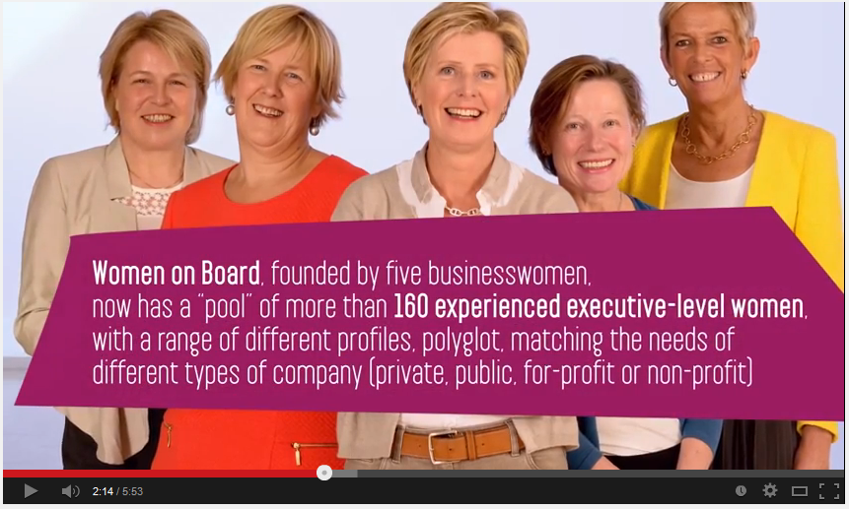
5 December 2013
Teaser
https://www.youtube.com/watch?v=WBqU5Naq0Yg&feature=player_embedded

Slide 37
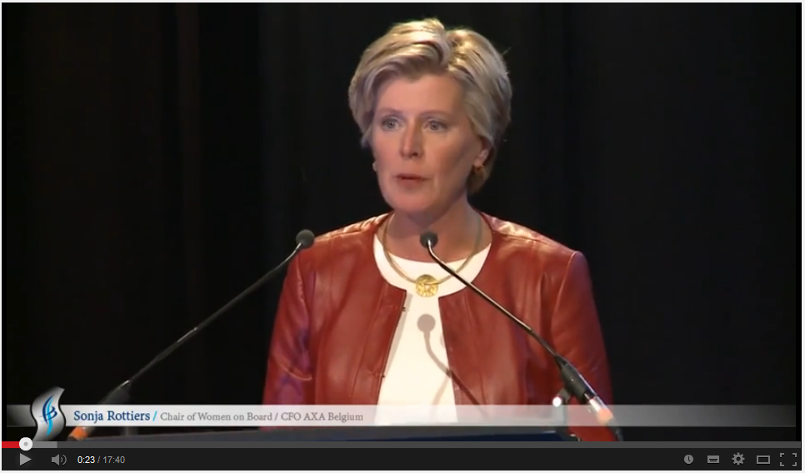
5 December 2013
Launch event
http://www.youtube.com/watch?v=wByvIZ8t1zI&feature=youtu.be

Slide 38
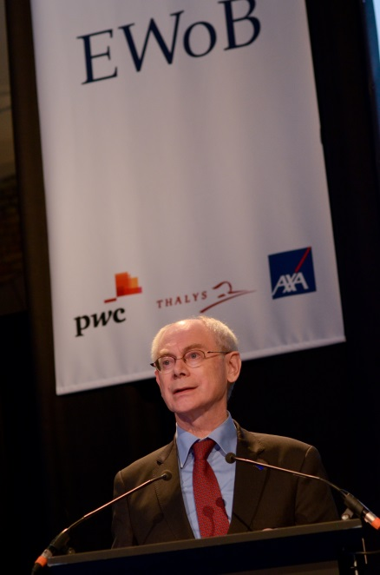
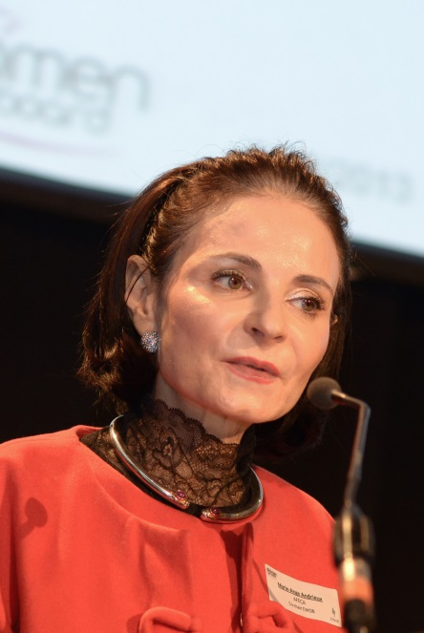
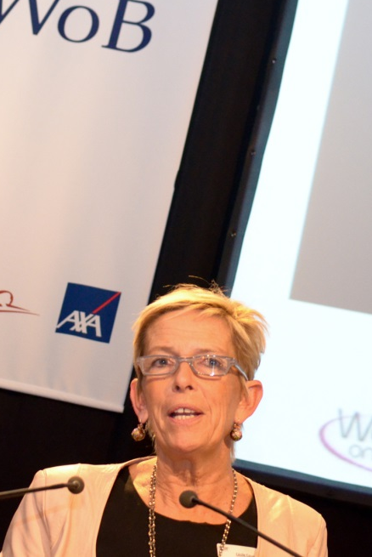
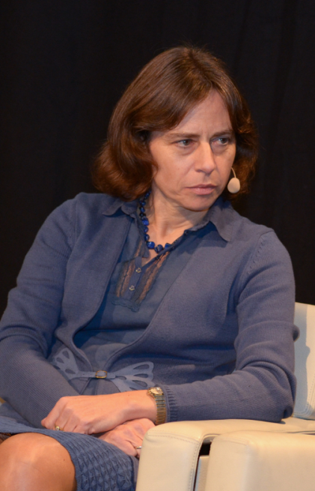
5 December 2013
Pictures
Herman Van Rompuy
President European Council
Marie-Ange Andrieux
AFECA co-Chair EWoB
Cécile Coune
CEO, Aviabel
co-Chair EWoB
Dominique Leroy
CEO & Board member, Belgacom

Slide 39
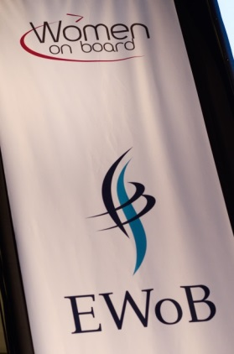
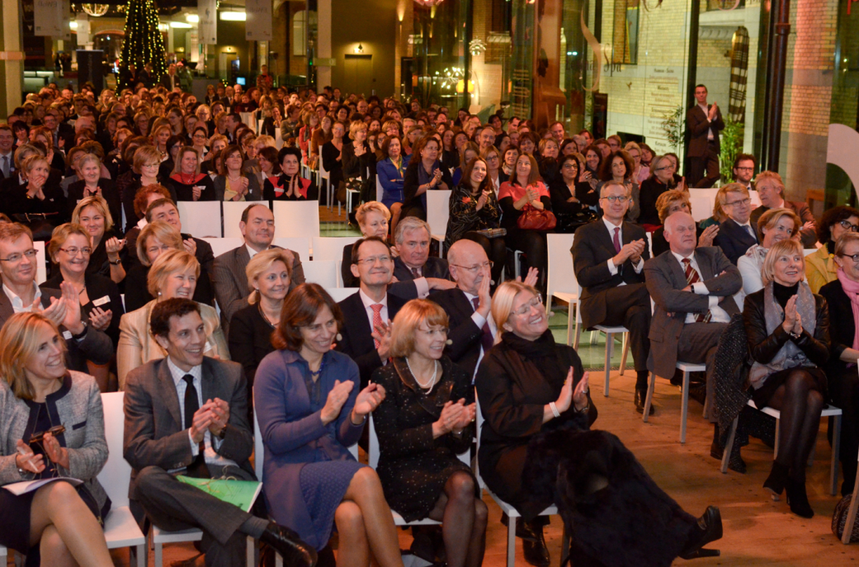
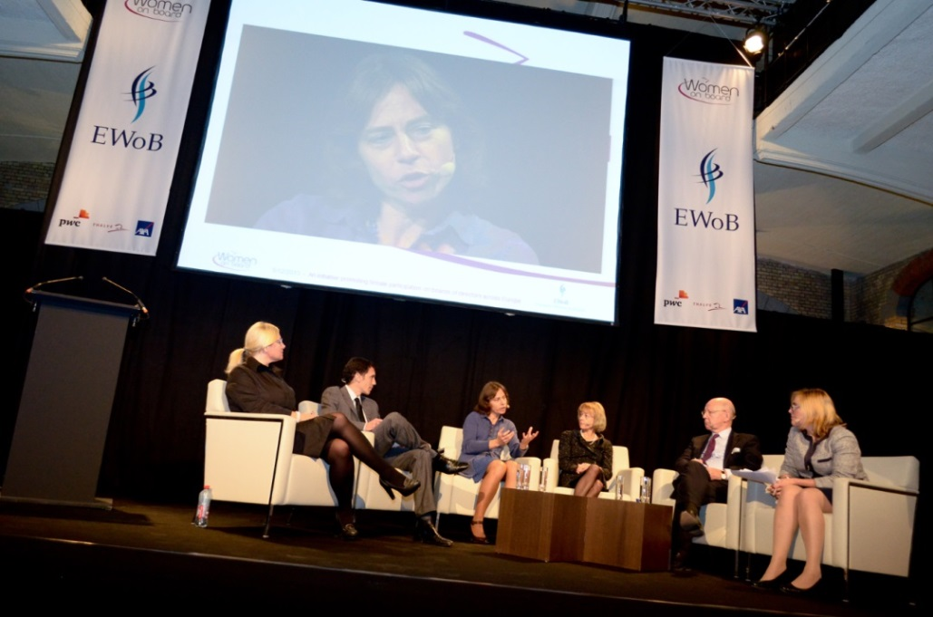
5 December 2013
Pictures

Slide 40
SAVE THE DATE!
5 MARCH 2015
AT 6PM
WOMEN ON BOARD AND EUROPEAN WOMEN ON BOARDS EVENT
MICHELE SIOEN, CHAIRWOMEN OF FEB/VBO
MARIANNE THYSSEN, EUROPEAN COMMISSIONER FOR EMPLOYMENT, SOCIAL AFFAIRS, SKILLS AND LABOUR MOBILITY
on
women’s impact in the Belgian & European labour market
(in particular, women at the top)
-exact title still to be confirmed-
40

