Slide 1
Operationnal Risk Management
Collaboration PRMIA / Belrim
18/09/2014

Slide 2
Agenda
Welcome
Membership
Board & support functions
Scientific Committee Objectives
Relation with FERMA
Main Objectives
Objectives and activities foreseen in 2014-2015
Notes:
No need to decide now

Slide 3
Membership
On 04/09/2014:
Effective members: 98
(industrial, commercial, financial or public companies)
Affiliated members: 98
(persons interested in risk management)
. Academics: 7
Notes:
No need to decide now

Slide 4
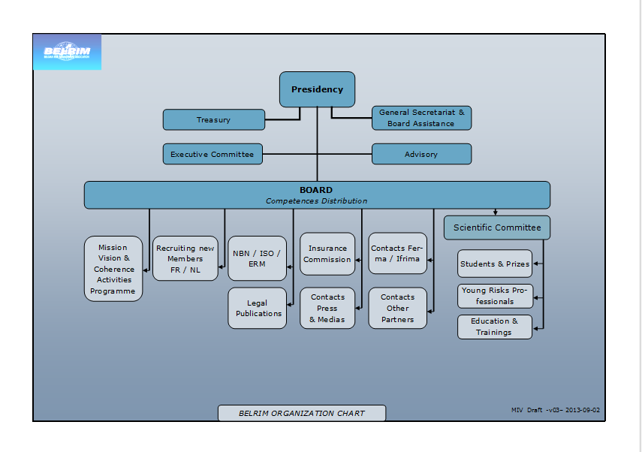
How are we organized ?

Slide 5
Scientific Committee Objectives
Promote Risk Management with young professionals and students
Make Risk Managers aware of existing and develop Risk Management courses, events and publications
Suggest and participate in Risk Management study topics
Focus 2014-2015

Slide 6
Relation with FERMA
Board members:
Carl LEEMAN
Johan WILLAERT (Vice-President)
Scientific Committee:
Gaëtan LEFEVRE
Hot topics:
Ferma Seminar in Brussels
Ferma Forum in Venice in 2015
Risk Management certification project
…
Notes:
No need to decide now

Slide 7
What are the main objectives ?
To offer its members an opportunity to exchange professional experiences
To defend the interests of its members with regard to regulatory authorities in different fields (ERM, Legal, Corporate Governance,…)
To make proposals in legal, fiscal, administrative, technical and other fields in order to avoid risks and to improve the protection and insurance conditions of the companies and turn risks into opportunities
www.belrim.com

Slide 8
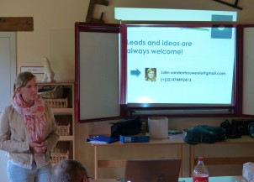
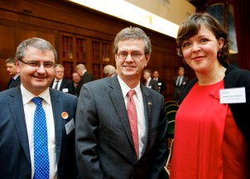
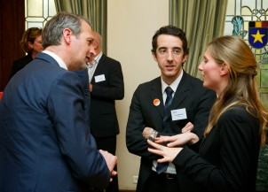
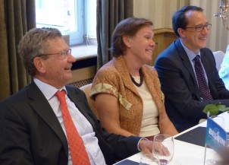
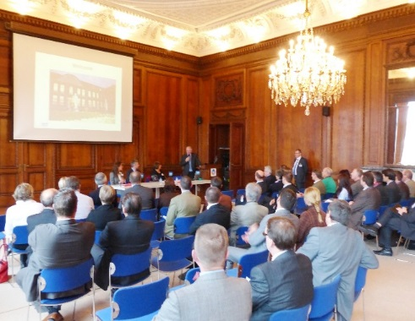
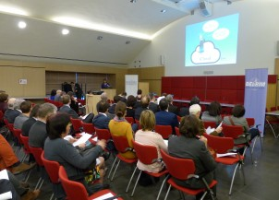
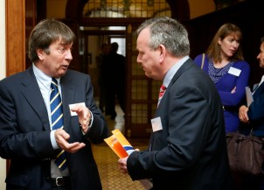
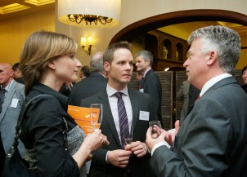
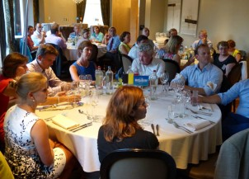
How do we meet these ?

Slide 9
Objectives and activities foreseen in 2014-2015
Foreseen activities:
PRMiA – Operational Risks
RM in Africa, jointly with Commercial Risks Europe
Ferma Seminar in Brussels
Supply chain
40 Y – The Place to Be
…
More details on our website
Notes:
No need to decide now

Slide 10
Objectives and activities foreseen in 2014-2015
Objectives:
increase the visibility of Belrim & attract new members
focus on Young Risk Professionals
We need your support !
Notes:
No need to decide now

Slide 11
The End…
Thank you for your attention
Notes:
No need to decide now

